Slide 1
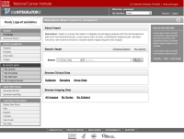
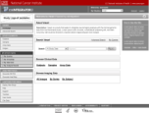

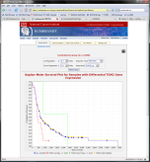
How caIntegrator2 works
Software Development Team
Project Team
Public
View Study
Array Data
caIntegrator2
caArray
Project Team
TBD
Deploy Study
Study Manager
Clinical Data
Images
NCIA
Image Annotations
TBD
caIntegrator2
caIntegrator
Array Data
Project Team
Public
Software Development Team
Project Team
Clinical Data
Rembrandt (for example)
Imaging Data
Process repeated again for each project, reusing code and developer expertise.

Slide 2
What you can do with caIntegrator2

Slide 3
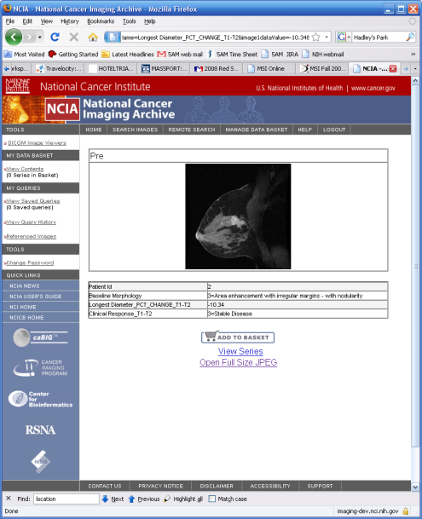
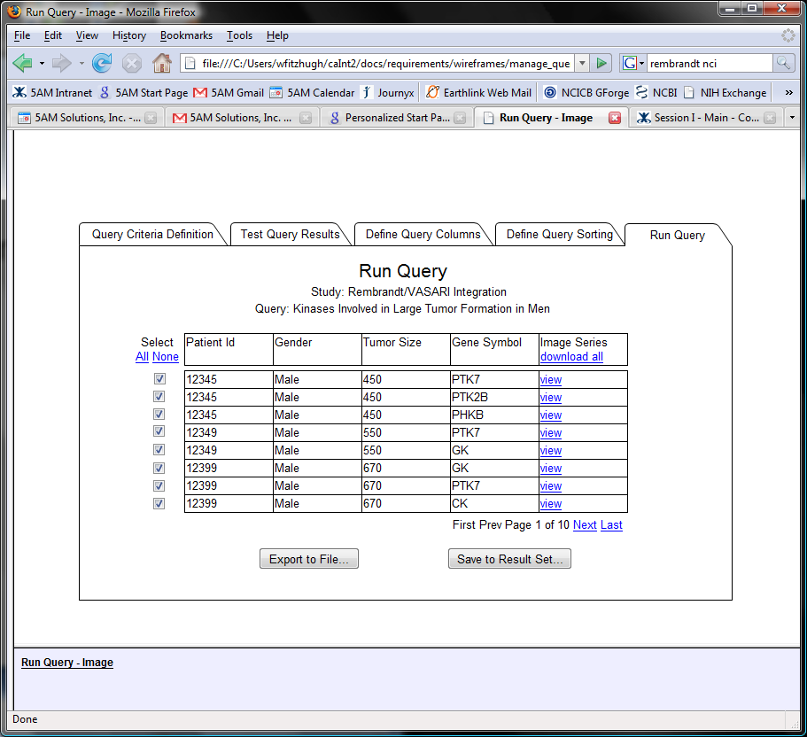
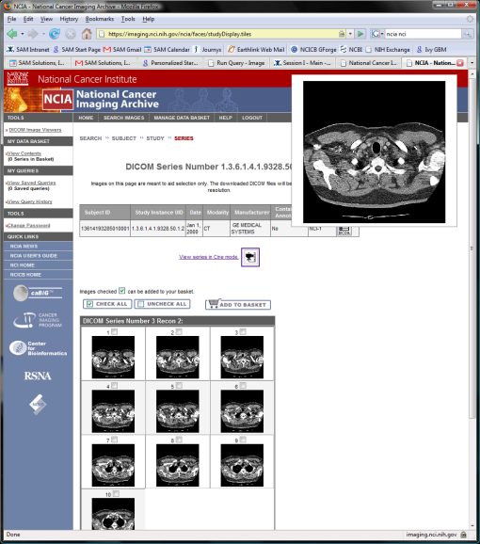
Current Plans for Image Viewing

